Slide 1
PLACEMENT UPGRADE
MENTOR - MD. AMIR KHAN

Slide 2
TEAM MEMBERS
NAZIA FARHEEN
II. SAMRADHI KHARE
III.SHUBHANSHI CHAUDHARY

Slide 3
TABLE OF CONTENTS
INTRODUCTION
OBJECTIVE
PROBLEM STATEMENT
MOTIVATION
WORKING METHODOLOGY
CONCLUSION
FUTURE SCOPE

Slide 4
INTRODUCTION
This app is developed in a manner so that students get details of company for which they are eligible with tentative dates. By using this app students will have got the idea of what should they exactly do for the future scope or we can say that placement.

Slide 5
OBJECTIVE
The main objective of “PLACEMENT UPGRADE” is to resolve approximately 70% of the student doubts regarding placement and manual work of managing placement regarding information.
It manages the placement details according to the students’ criteria for the eligibility.
Saves the time of placement officer and faculties.
Reduces the manual works.

Slide 6
PROBLEM STATEMENT
In colleges the records were stored in excel sheets that are also less advanced.
Updating Records is another tedious task.
There is also a large communication gap between students and the placement officers as it is difficult to maintain coordination between them.
All the records are main- trained manually.

Slide 7
MOTIVATION
Placement is a very crucial time. A small mistake can ruin students’ life very easily. Colleges and university also showing lots of efforts to maintain updation about placement for the students. But mostly work is done by email and website. So we got an idea to develop an android application “PLACEMENT UPGRADE”.

Slide 8
WORKING METHODOLOGY
HOW PLACEMENT UPGRADE WORKS

Slide 9
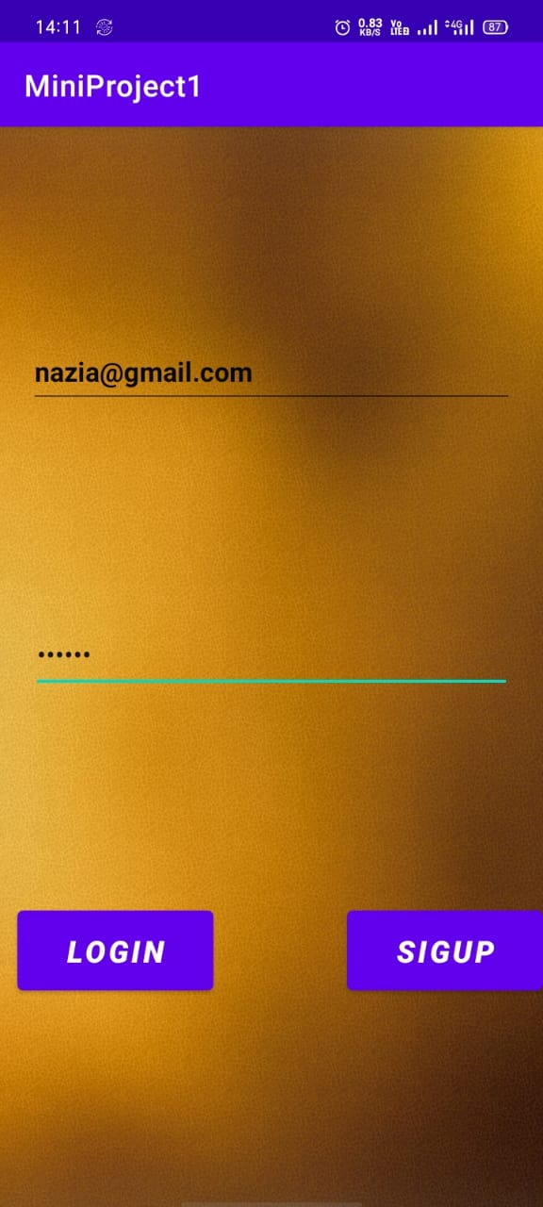
LOGIN PAGE
This is our first page that is login page. Here students will login by their email and password.

Slide 10
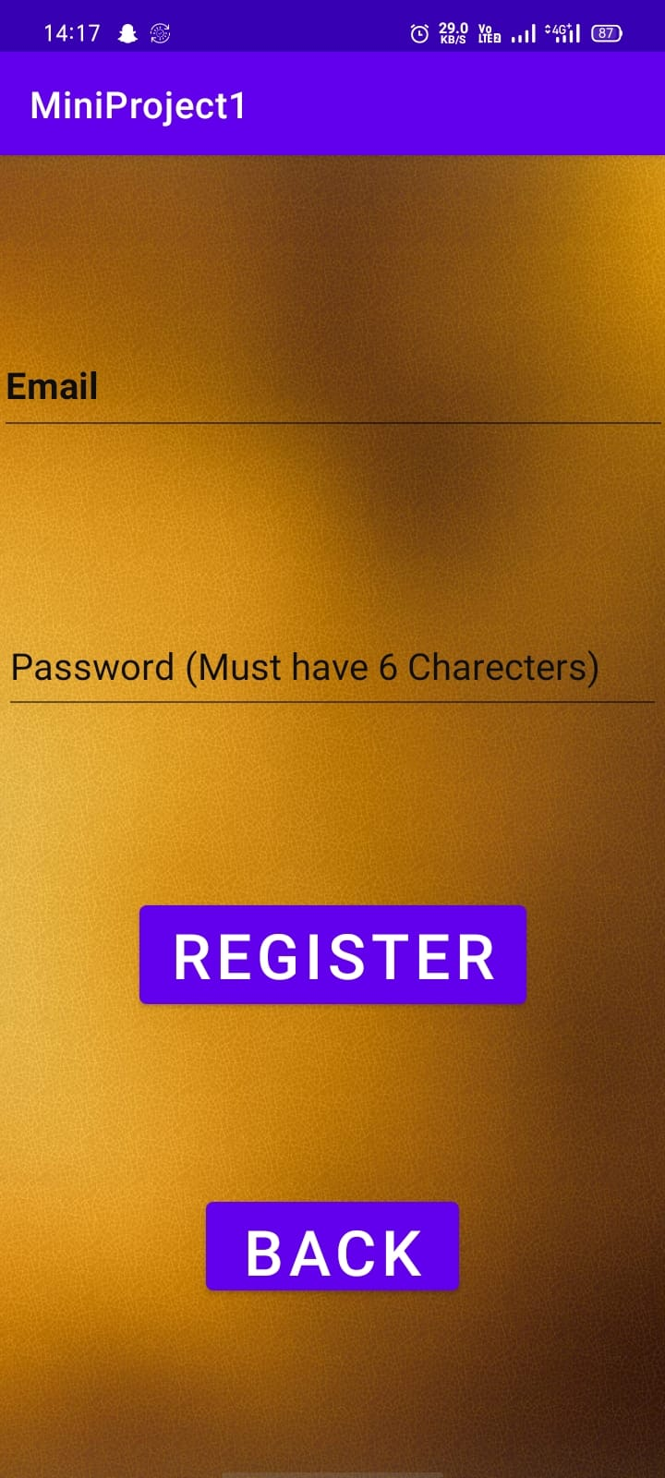
REGISTRATION PAGE
For new students who want to register themselves.

Slide 11
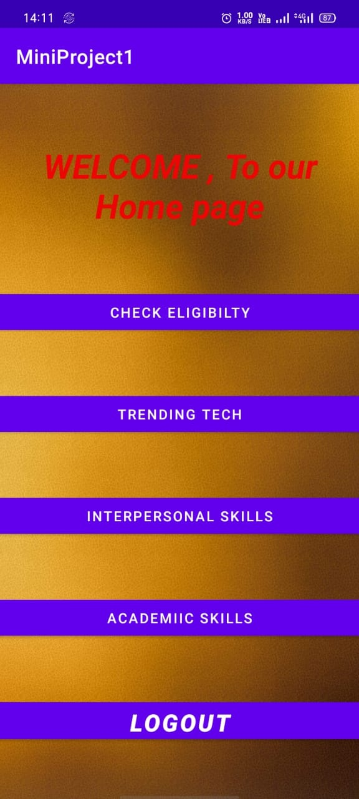
HOME PAGE
This is the home page where students get various option to clear their doubts.

Slide 12
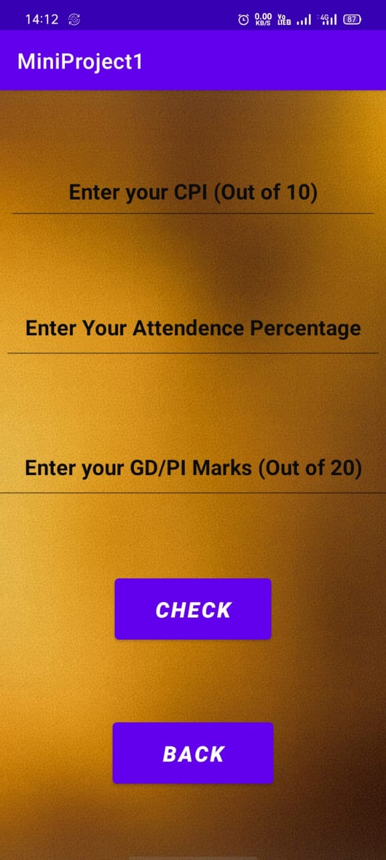
ELIGIBITY CHECK
Here students will enter their details and get know that they are eligible or not.

Slide 13

TECHNICAL UPDATE
Here we provide the information of current technology so that students will get updated.

Slide 14
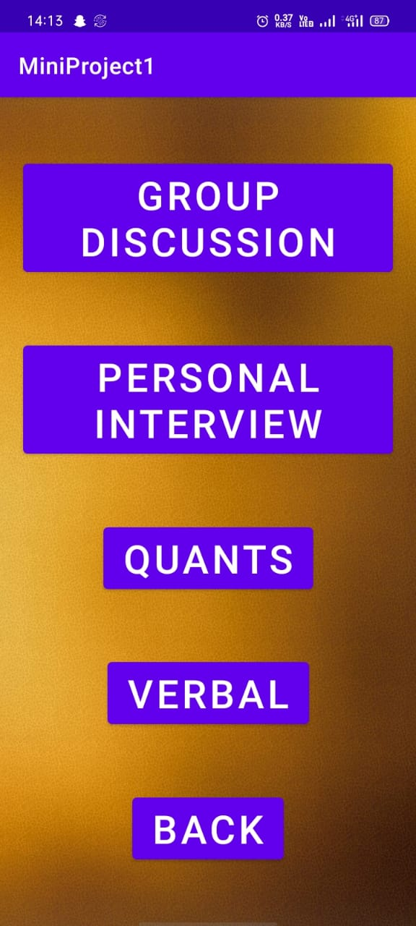
INTERPERSONAL SKILLS
Here students get information about interpersonal skills that are important as per placement.

Slide 15
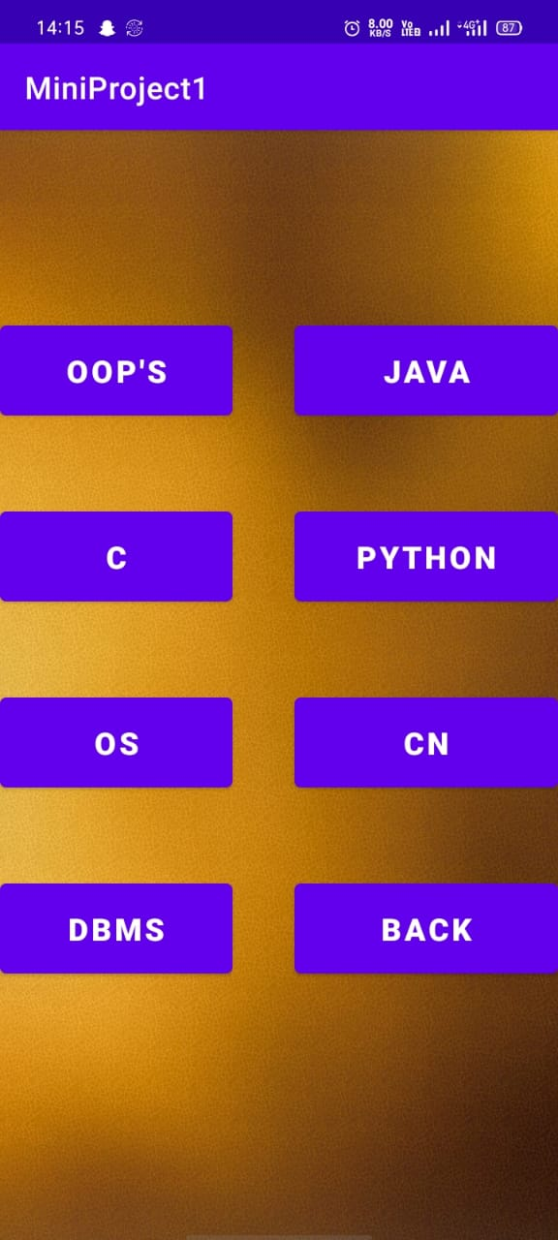
ACADEMIC SKILLS
Here students get details and resources of academic subjects that are important for placement.

Slide 16
CONCLUSION
In the proposed system, all of the problems become automated.
The registration of the student for an upcoming placement.
The addition of a new user.
Notifying students.
Sharing information.
The privacy of the student, etc.

Slide 17
FUTURE SCOPE
We will add a database where student can save their data like certificates, resume etc.
We will make a portal for administration which will also have access to use this app but only administrator department of app.
We will make every data entry of the students verified by the administrator of the particular college.

